Slide 1

Discussion Forums as assessment
Stephen Thomas, Ph.D.
Digital Curriculum Coordinator, College of Natural Science
Associate Director for the Center for Integrative Studies in General Science
sthomas@msu.edu

Slide 2
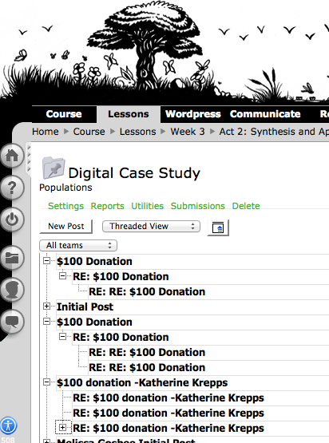
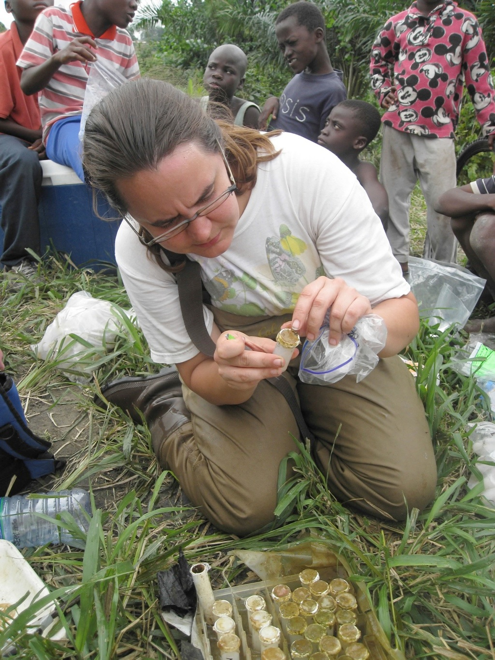
Once upon a time…
Objective: Students will be able to describe how organisms survive in suboptimal environmental conditions, maintain temperature, and balance water and solutes.

Slide 3
FOR YOUR INITIAL POST:
Describe how the concept of metapopulations applies to gypsy moth spread? Give a couple of examples of questions you have / things you find confusing / things you want to more on. In your responses to others, help them with their questions, confusions, or interests.
FOR YOUR INITIAL POST:
You have the chance to donate your $100 to one of these organizations or leave the fair and give your money to another organization. Would you donate your money to any of these organizations? If so, which one and describe the reasons driving this decision. If not, where would you donate your money and why?

Slide 4
Most important component to reach course objectives.
%

Slide 5
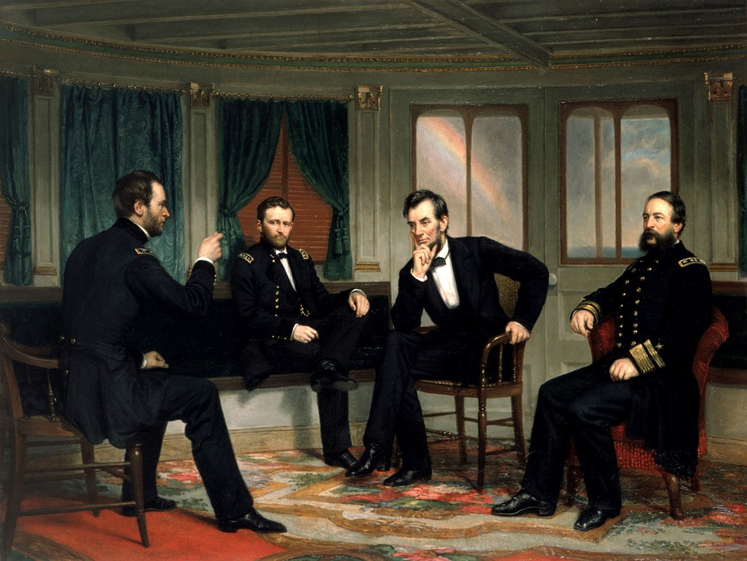
Discussion forum as organic dialogue.

Slide 6

Discussion
forum
as
structured
response or correspondence.

Slide 7
Types of approaches
Discussions of course materials
Collaborative projects
Private Journal
Debates
Research panel
Peer editing
Problem-solving activities
Brainstorming forums
Notes:
https://business.uc.edu/content/dam/business/Technology/E-Learning/Discussion%20Board%20Examples.pdf

Slide 8
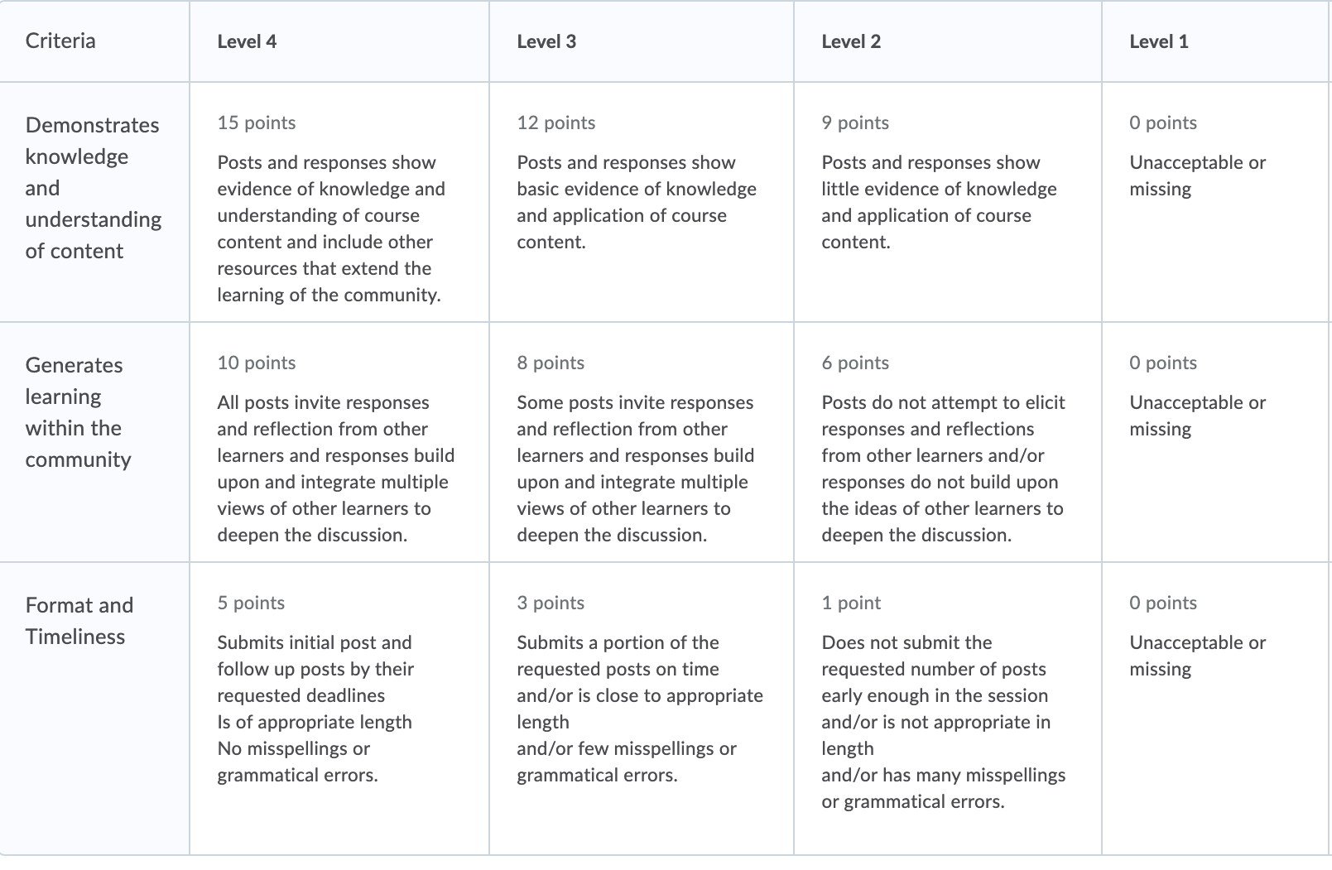
D2L Rubrics

Slide 9
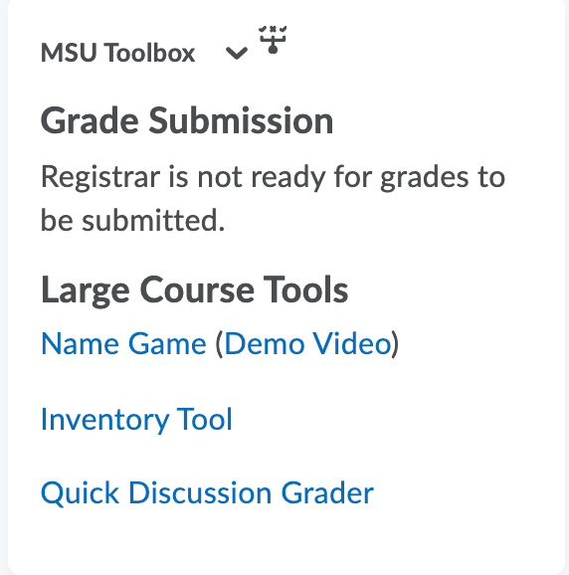
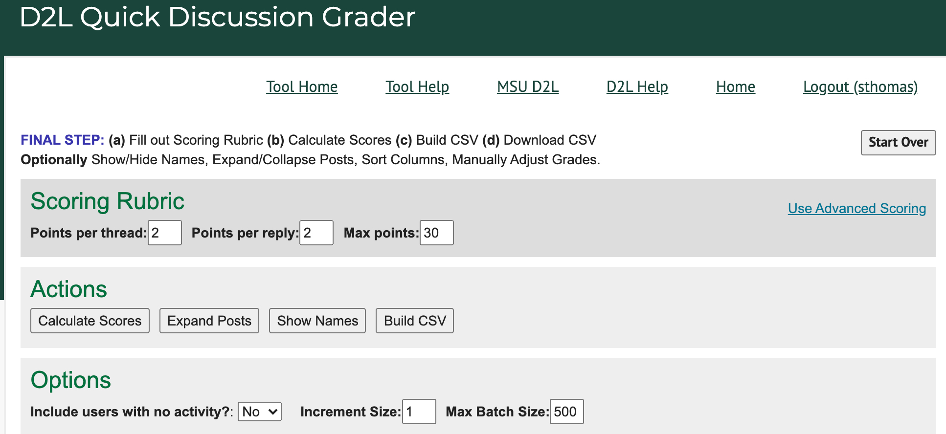
Quick Discussion Forum Grader

Slide 10
Types of feedback
Student
Faculty
Self-reflection

Slide 11
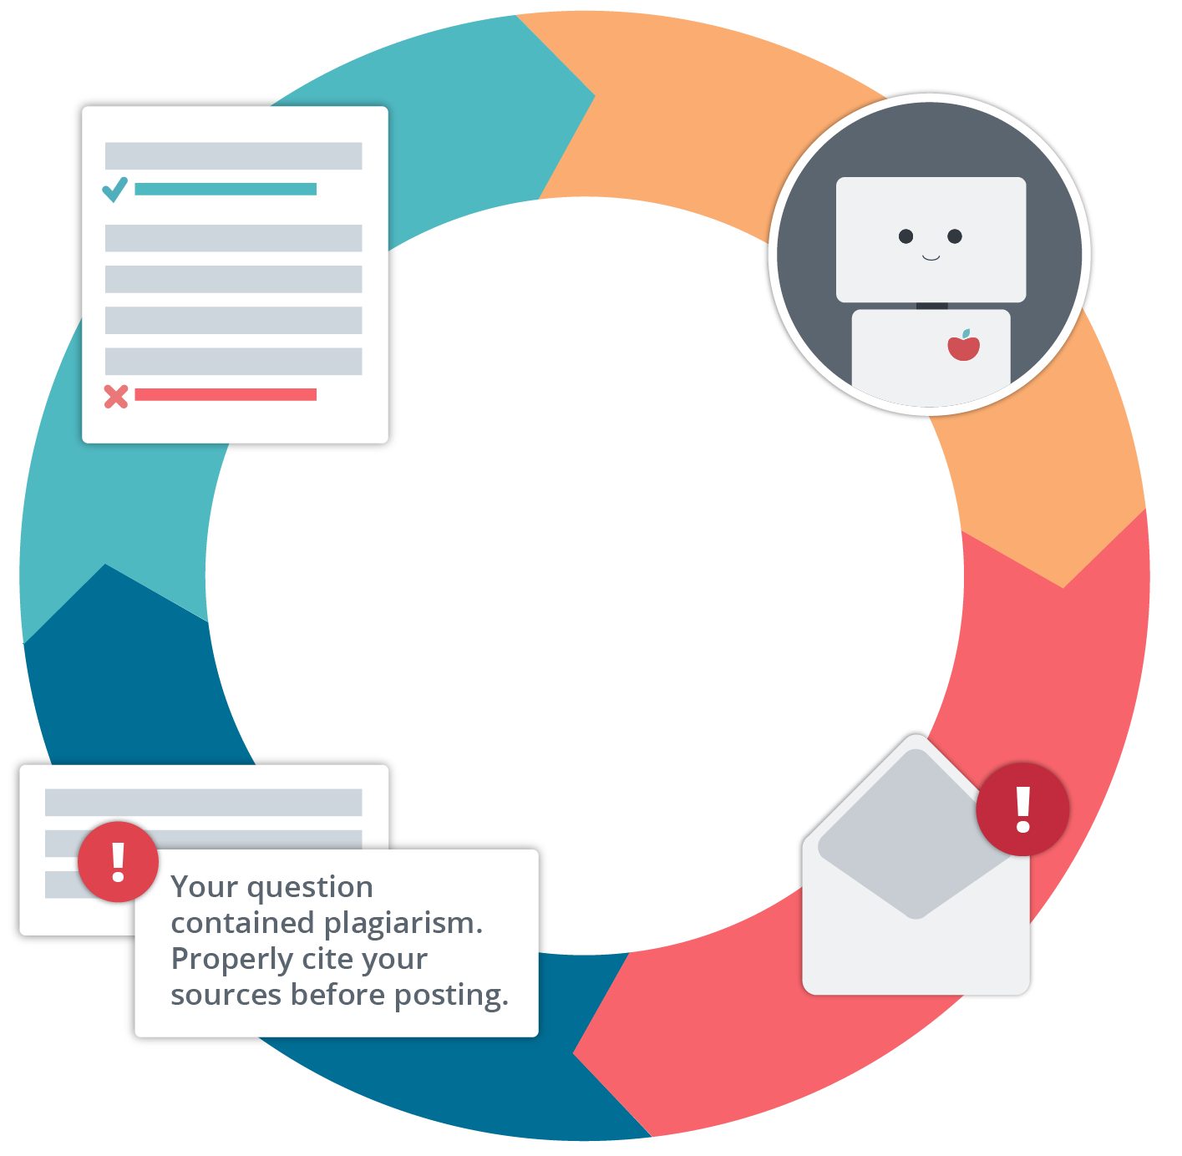





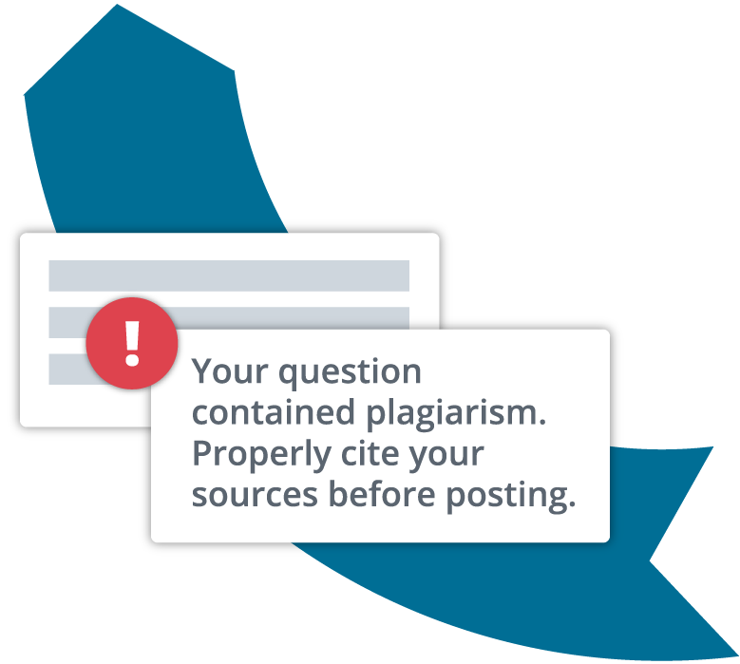
Packback’s
DigitalTA™
Packback’s DigitalTA AI provides instant, consistent feedback to students about how to elevate their discussion posts. DigitalTA automatically moderates posts that do not meet standards, giving them a chance to revise.
Post Submitted
Write
Students get real-time feedback while typing to help them proactively improve their writing.
AI Review
• Closed-Ended Questions
• Plagiarism
• Insufficient Length
• Class Logistics Content
• Profanity or Abuse
Post Moderated
Revise
The student is prompted to improve and republish their post, allowing them to apply and learn from feedback.
Coach
The student receives a coaching email with feedback about why their post was moderated.
Notes:
2 min

Slide 12
Recommendations
Provide rubric
Netiquette
Initial post due date
Initial response due date
Define expectations

Slide 13
Resources
Slides from this talk
Netiquette
Student instructions on post writing
Sample discussion forum rubric
D2L Self-enrollment tool
Description of Piazza
Powerpoint overview of Packback

